Slide 1


Ashkan Zand
14 December 2024

Slide 2

Outline
Executive Summary
Introduction
Methodology
Results
Conclusion
Appendix

Slide 3
Executive Summary
Summary of methodologies
SpaceX Dada Collection using SpaceX API and Web Scraping
Data Wrangling
Exploratory Data Analysis with Data Visualization and SQL
Space-X Launch Sites Analysis with Folium-Interactive Visual Analytics and Ploty Dash
Machine Learning Landing Prediction
Summary of all results
Exploratory Data Analysis results
Interactive Visual Analytics and Dashboards
Predictive analysis results

Slide 4
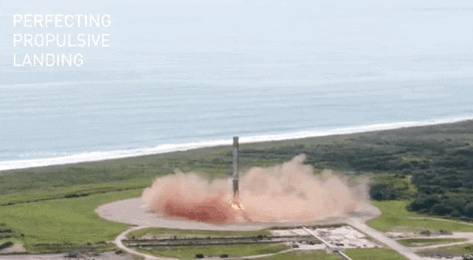
Introduction
Project background and context
SpaceX advertises Falcon 9 rocket launches with a cost of 62 million dollars.
Other providers cost upward of 165 million dollars each, much of the savings is because SpaceX can reuse the first stage.
Therefore if we can determine if the first stage will land, we can determine the cost of a launch.
Problems you want to find answers
We will predict if the Falcon 9 first stage will land successfully using the data from Falcon 9 rocket launches advertised on its website

Slide 5

Section 1

Slide 6
Methodology
Executive Summary
Data collection methodology:
Describe how data was collected
Perform data wrangling
Describe how data was processed
Perform exploratory data analysis (EDA) using visualization and SQL
Perform interactive visual analytics using Folium and Plotly Dash
Perform predictive analysis using classification models
How to build, tune, evaluate classification models

Slide 7
Data Collection
Data is collected using SpaceX API (a RESTful API)
Also, Web Scraping is performed to collect Falcon 9 historical records from the Wikipedia page titled List of falcon 9 and Falcon Heavy launches.

Slide 8
Data Collection – SpaceX API
Collecting Rocket launch data from SpaceX API, by sending a get request.
Decoding the response content as a JSON
Turing JSON results into a Pandas Data Frame.
HERE the GitHub URL of the completed SpaceX API calls notebook: https://github.com/AshkanZand/Projects/blob/a8434070144e71307f1cc15d38022552e389a4a1/SpaceX%20Falcon%209/jupyter-labs-spacex-data-collection-api.ipynb
SpaceX API
Data
requests.get(spacex_url)
JSON
response.json()
Data Frame
pd.json_normalize

Slide 9
Data Collection – Web Scraping
Wiki URL
Performing an HTTP GET method to request the Falcon9 Launch HTML page
Creating a BeautifulSoup object from the HTML response
Creating a data frame by parsing the launch HTML tables
HERE is the GitHub URL of the completed Web Scraping notebook: https://github.com/AshkanZand/Projects/blob/a8434070144e71307f1cc15d38022552e389a4a1/SpaceX%20Falcon%209/jupyter-labs-webscraping.ipynb
html content
requests.get(static_url)
SOUP
BeautifulSoup(html_content)
Data Frame
pd.DataFrame()

Slide 10
Data Wrangling
Filtering created Data Frame to only keep Falcon 9 lunches
Replacing missing data values in the LandingPad and PayloadMass columns by mean value of the column
Creating a landing outcome label (0 or 1) from Outcome column
HERE is the GitHub URL of the completed Data Wrangling notebook: https://github.com/AshkanZand/Projects/blob/a8434070144e71307f1cc15d38022552e389a4a1/SpaceX%20Falcon%209/labs-jupyter-spacex-Data%20wrangling.ipynb
Filtering Data
Replacing missing data
Creating outcome column (“Class”)

Slide 11
EDA with Data Visualization
Using scatter plots to visually check if there are any relationship between
Flight Number and Payload Mass
Flight Number and Launch Site
Payload Mass and Launch Site
Flight Number and Orbit type
Payload Mass and Orbit type
Using Bar chart to Visualize the relationship between success rate of each orbit type
Using Line plot to Visualize the launch success yearly trend
HERE is the GitHub URL of the completed EDA with Data Visualization notebook: https://github.com/AshkanZand/Projects/blob/a8434070144e71307f1cc15d38022552e389a4a1/SpaceX%20Falcon%209/edadataviz.ipynb

Slide 12
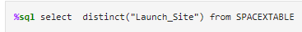



EDA with SQL
EDA were performed using following SQL queries:
Display the names of the unique launch sites in the space mission
Display 5 records where launch sites begin with the string 'CCA’
Display the total payload mass carried by boosters launched by NASA (CRS)
Display average payload mass carried by booster version F9 v1.1

Slide 13


EDA with SQL
EDA were performed using following SQL queries:
List the date when the first succesful landing outcome in ground pad was acheived.
List the names of the boosters which have success in drone ship and have payload mass greater than 4000 but less than 6000
List the total number of successful and failure mission outcomes
%sql select "Booster_Version" from SPACEXTABLE where ("Landing_Outcome" = "Success (drone ship)" and 4000<"PAYLOAD_MASS__KG_"<6000)

Slide 14
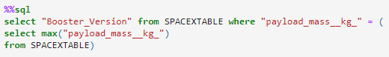
EDA with SQL
EDA were performed using following SQL queries:
List the names of the booster_versions which have carried the maximum payload mass. Use a subquery
List the records which will display the month names, failure landing_outcomes in drone ship ,booster versions, launch_site for the months in year 2015.
%%sql
select substr(Date, 6,2),"Landing_Outcome", "Booster_Version", "Launch_Site" from SPACEXTABLE where ( substr(Date,0,5)='2015' and Landing_Outcome like "Failure (drone ship)")

Slide 15

EDA with SQL
EDA were performed using following SQL queries:
Rank the count of landing outcomes (such as Failure (drone ship) or Success (ground pad)) between the date 2010-06-04 and 2017-03-20, in descending order.
HERE is the GitHub URL of the completed Web Scraping notebook: https://github.com/AshkanZand/IBM-Data-Science-Professional/blob/969feeda7844a92d3d68133dcbc0ab2d6b4881e1/SpaceX-Falcon-9/jupyter-labs-eda-sql-coursera_sqllite.ipynb

Slide 16
Build an Interactive Map with Folium
Creating folium map to marked all the launch sites
Creating map objects such as markers, circles, lines to mark the success or failure of launches for each launch site on the map.
Creating a marker with distance to a closest city and drawing a line between the marker to the launch site
HERE is the GitHub URL of the completed Web Scraping notebook: https://github.com/AshkanZand/IBM-Data-Science-Professional/blob/969feeda7844a92d3d68133dcbc0ab2d6b4881e1/SpaceX-Falcon-9/lab_jupyter_launch_site_location.ipynb

Slide 17
Build a Dashboard with Plotly Dash
Built an interactive dashboard application with plotly dash by:
Adding a Launch Site Drop-down Input Component
Adding a Callback Function to render Success-Pi-Chart based on selected Site Dropdown
Adding a Range Slider to Select Payload
Adding a Callback Function to render the Success-Payload-Scatter-Chart scatter plot
HERE is the GitHub URL of the completed Web Scraping notebook: https://github.com/AshkanZand/IBM-Data-Science-Professional/blob/969feeda7844a92d3d68133dcbc0ab2d6b4881e1/SpaceX-Falcon-9/spacex_dash_app.py

Slide 18
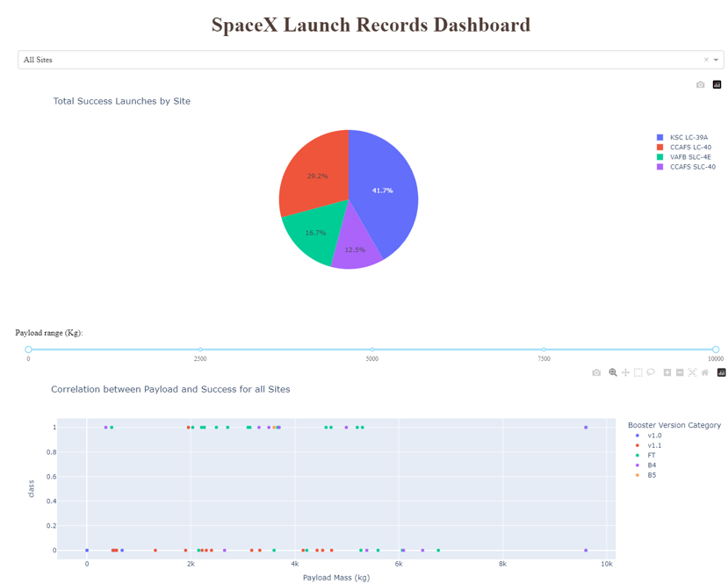
Build a Dashboard with Plotly Dash

Slide 19
Predictive Analysis (Classification)
create a column for the class -> data["Class"].to_numpy()
Loading the data as a Pandas Dataframe and performing exploratory Data Analysis and determining Training Labels Using Sklearn Library
Finding the best ML Model/method using the Test Data between SVM, Classification Trees, K nearest neighbors and Logistic Regression
Standardize the data -> preprocessing.StandardScaler()
Split into training data and test data -> train_test_split(X, Y, test_size=0.2, random_state=2)
Creating a GridSearchCv object for each model -> GridSearchCV(estimator=, param_grid, cv=10)
Finding the best Hyperparameter and best Score using the validation data
Using the method Score to calculate the accuracy on the Test Data
Plotting a confusion matrix using the Test and prediction Outcomes

Slide 20
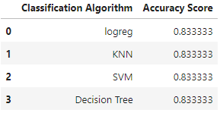
Predictive Analysis (Classification)
Compering the test data accuracy score for each Classification Algorithm to which one performed the best
HERE is the GitHub URL of the completed Web Scraping notebook: https://github.com/AshkanZand/IBM-Data-Science-Professional/blob/969feeda7844a92d3d68133dcbc0ab2d6b4881e1/SpaceX-Falcon-9/SpaceX_Machine%20Learning%20Prediction_Part_5.ipynb

Slide 21
Results
Exploratory data analysis results
Interactive analytics demo in screenshots
Predictive analysis results

Slide 22

Section 2

Slide 23
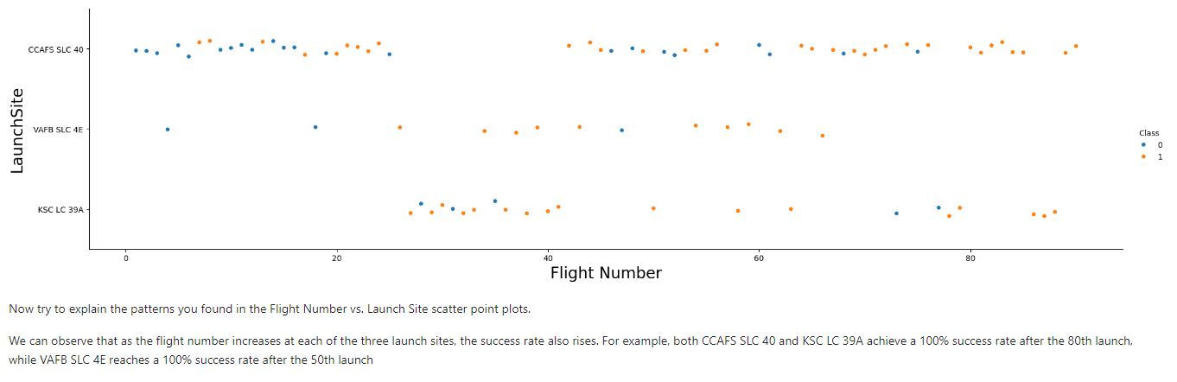
Flight Number vs. Launch Site
Scatter plot of Flight Number vs. Launch Site with explanation

Slide 24
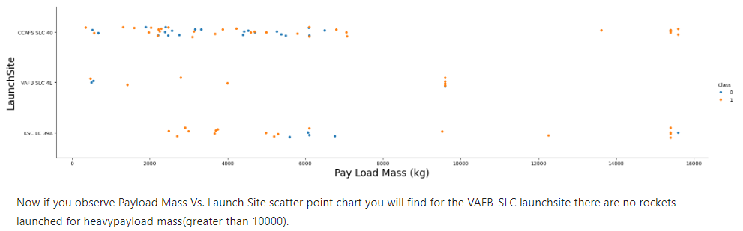
Payload vs. Launch Site
Scatter plot of Payload vs. Launch Site with explanation

Slide 25
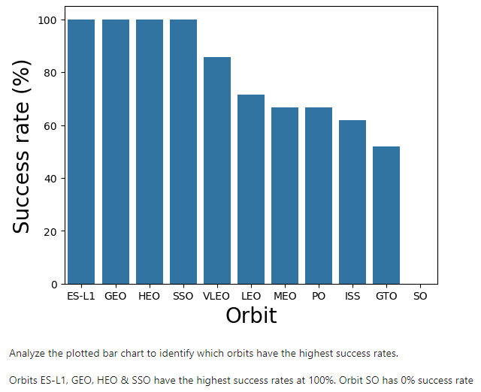
Success Rate vs. Orbit Type
Barchart for the success rate of each orbit type with explanation

Slide 26
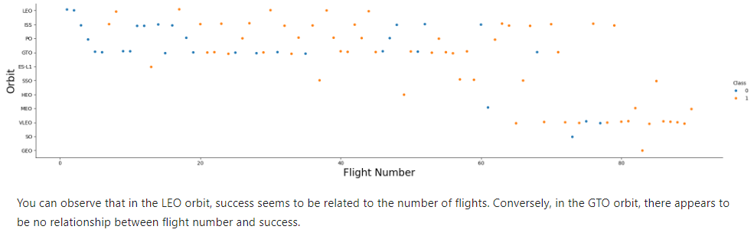
Flight Number vs. Orbit Type
Scatter plot of Flight number vs. Orbit type with explanations

Slide 27
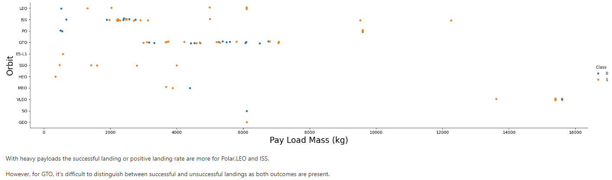
Payload vs. Orbit Type
Scatter point of payload vs. orbit type with explanations

Slide 28
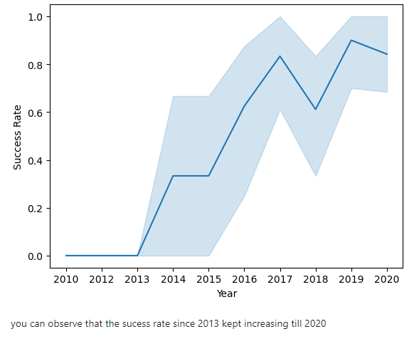
Launch Success Yearly Trend
Line chart of yearly average success rate with explanations

Slide 29
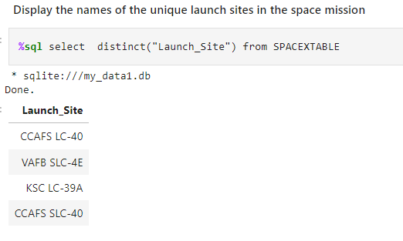
All Launch Site Names
Using “SELECT DISTINCT“ to return only the unique launch sites from the “LAUNCH_SITE“ column of the “SPACEXTBL“ table

Slide 30
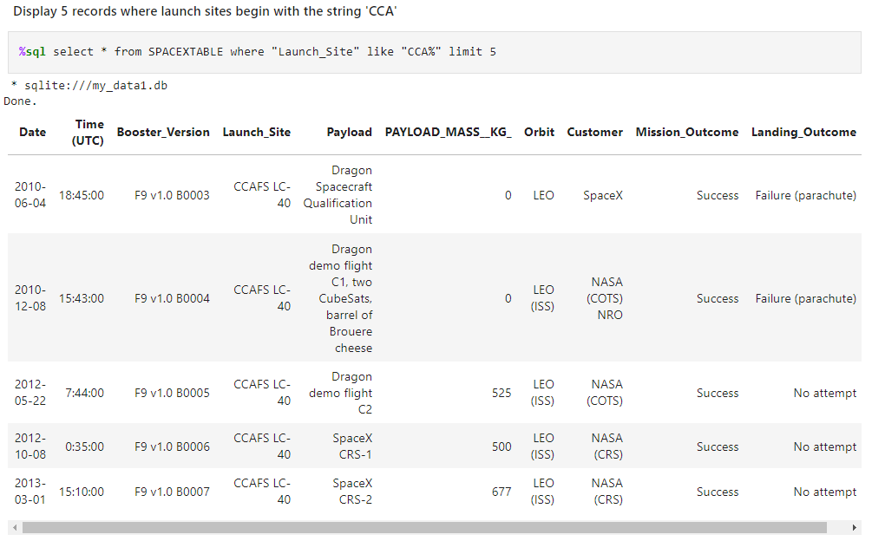
Launch Site Names Begin with 'CCA'
Used `LIKE` command with `%` wildcard in `WHERE` clause to select and display a table of all records where launch sites begin with the string `CCA`

Slide 31
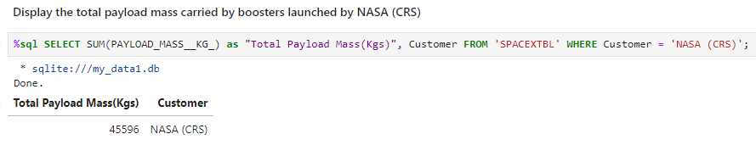
Total Payload Mass
Using the `SUM()` function to return and display the total sum of `PAYLOAD_MASS_KG` column for customer `NASA(CRS)`

Slide 32
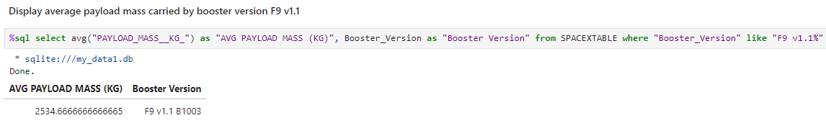
Average Payload Mass by F9 v1.1
Using `AVG()` function to return and display the average payload mass carried by booster version F9 v1.1

Slide 33
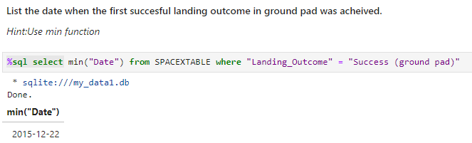
First Successful Ground Landing Date
Using the `MIN()` function to return and display the first (oldest) date when first successful landing outcome on ground pad `Success (ground pad)` happend

Slide 34
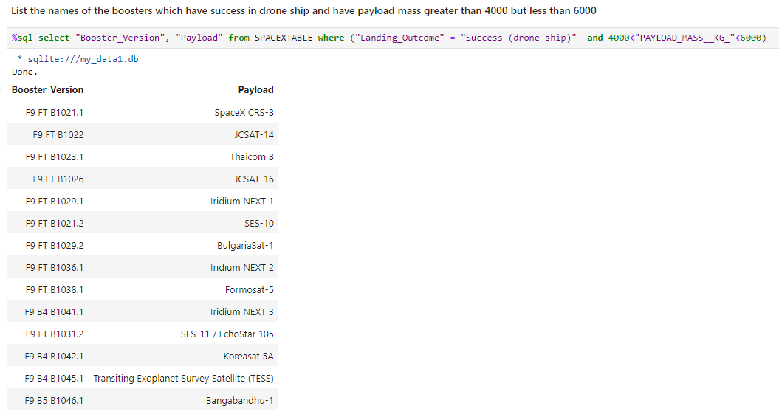
Successful Drone Ship Landing with Payload between 4000 and 6000
Using `SELECT` statement to return and list the names of boosters with payload between 4000 and 6000 with landing outcome of `Success (drone ship)`

Slide 35
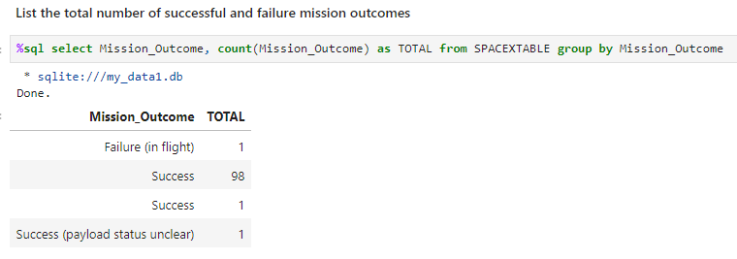
Total Number of Successful and Failure Mission Outcomes
Using `COUNT` together with the `GROUP BY` statement to return total number of missions outcomes

Slide 36
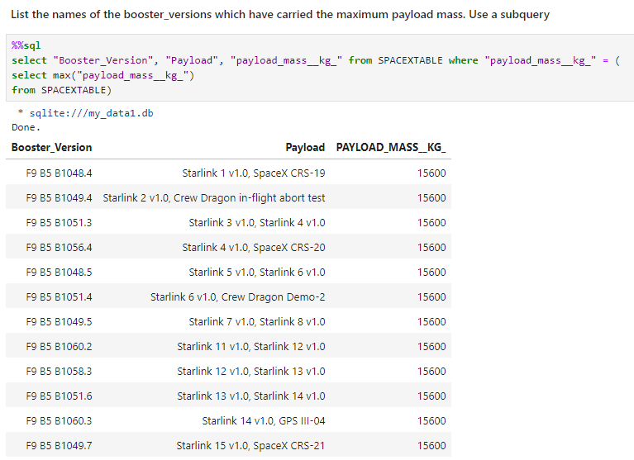
Boosters Carried Maximum Payload
Using a Subquerry to return and pass the Max payload and used it list all the boosters that have carried the Max payload.

Slide 37
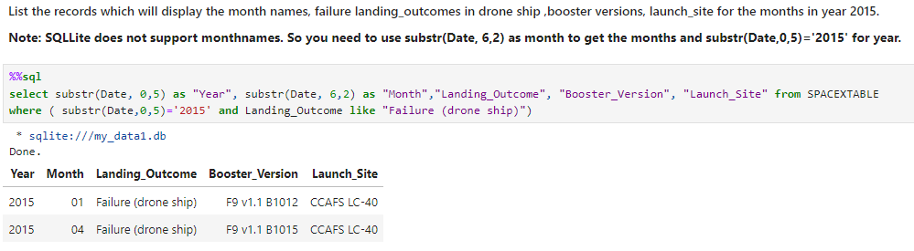
2015 Launch Records
Using the `subsrt()` in the select statement to get the month and year from the date column where substr(Date,0,5)=‘2015‘ for year and Landing_outcome was `Failure (drone ship)` and return the records matching the filter.

Slide 38
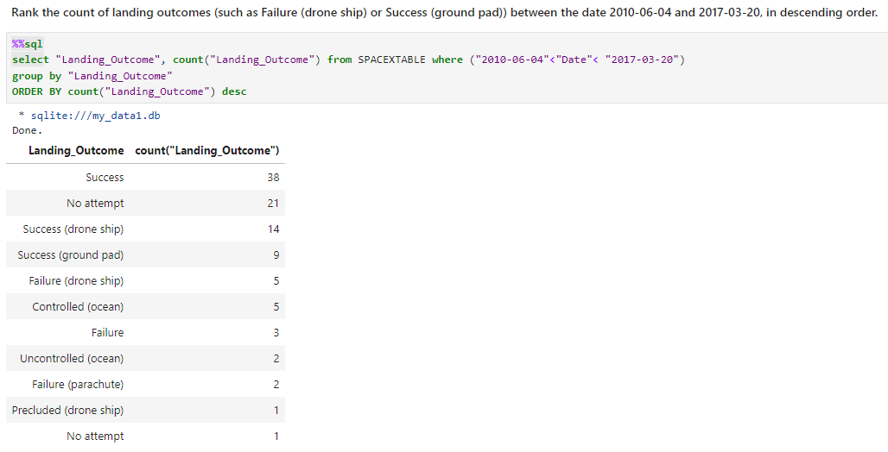
Rank Landing Outcomes Between 2010-06-04 and 2017-03-20
Ranking the count of landing using ‘COUNT’ and grouping the ‘Landing_Outcome’ and filtering the date between 210-06-04 and 2017-03-20, in descending order

Slide 39

Section 3

Slide 40
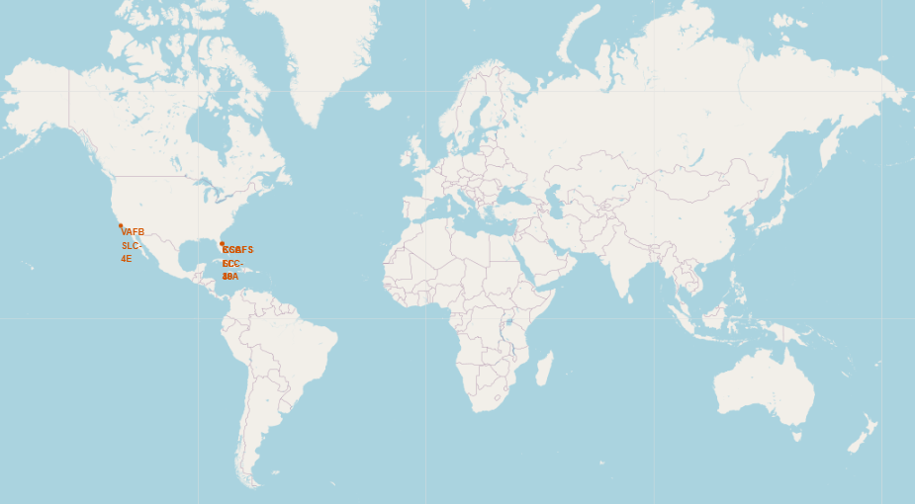
Markers of all Launch Sites on Global Map
All launch sites are in proximity to the Equator line
All launch sites are in very close proximity to the coast (located southwards of USA).

Slide 41
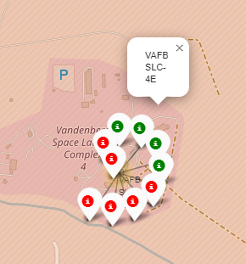
Launch Outcomes for each Site on the Map

Slide 42
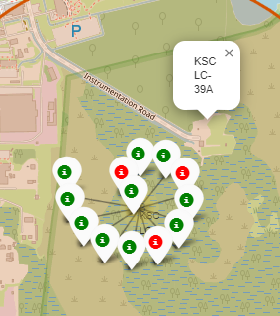
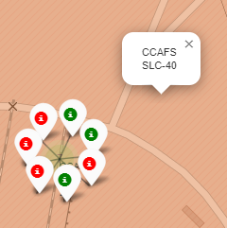
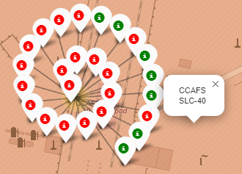
Launch Outcomes for each Site on the Map
East Coast Florida Sites
In the East Coast (Florida), KSC LC-39A has relatively high success rates (77%) compared to CCAFS SLC-40 (43%) and CCAFS LC-40 (27%).
In the West Coast (California), VAFB SLC-4E has relatively lower success rates (40%) compared to KSC LC-39A launch site in the East Coast.
West Coast California

Slide 43
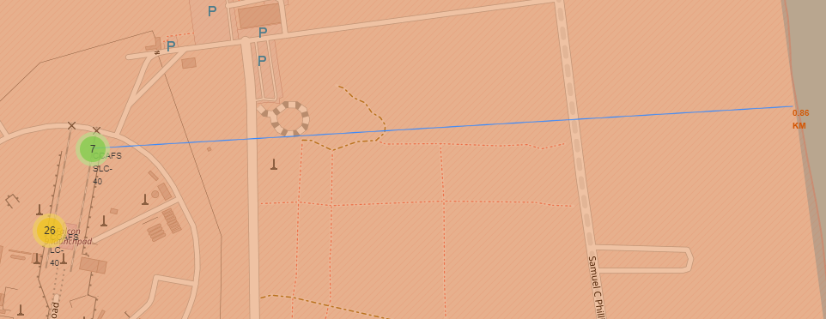
Distance between a launch site to its proximities
Launch site CCAFS SLC-40 proximity to coastline is 0.86 KM

Slide 44
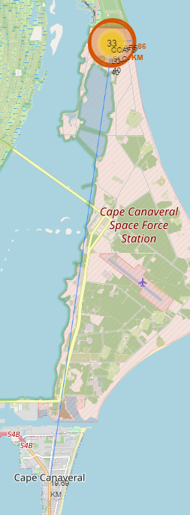
Distance between a launch site to its proximities
Launch site CCAFS SLC-40 proximity to the city Cape Canaveral is 19.69 KM

Slide 45

Section 4

Slide 46
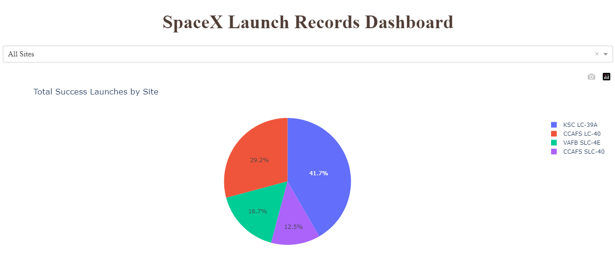
Pie-Chart for Launch success count for all sites
Launch site KSC LC-39A has the highest launch success rate at 42% followed by CCAFS LC-40 at 29%, VAFB SLC-4E at 17% and lastly launch site CCAFS SLC-40 with a success rate of 13%.

Slide 47
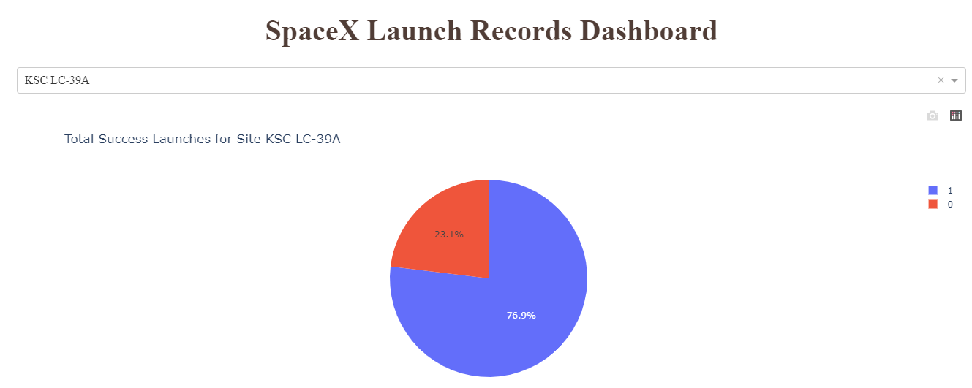
Pie-Chart for the Launch site with highest success rate
Launch site KSC LC-39A had the highest success ratio of 73% success against 27% failed launches

Slide 48
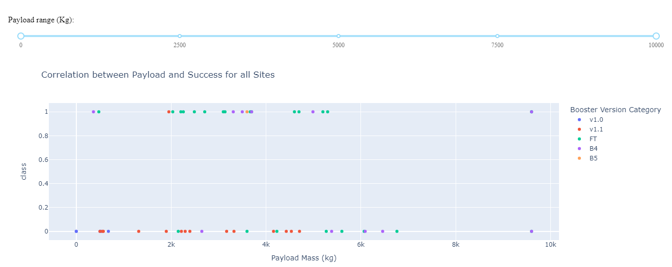
Payload vs. Launch outcome scatter plot for all sites
F9 Booster version FT has the highest launch success rate

Slide 49
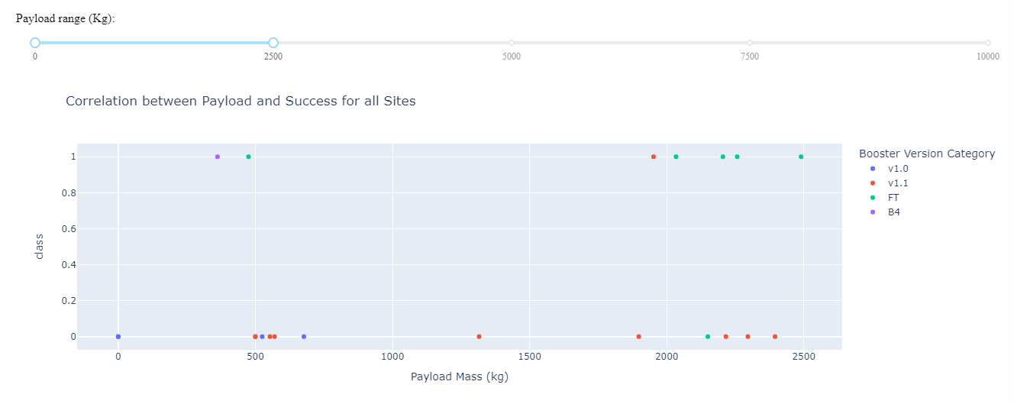
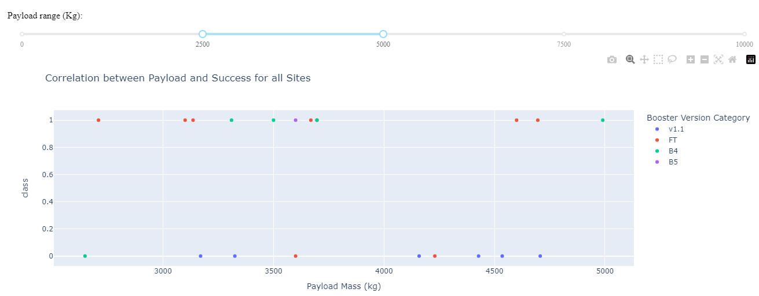
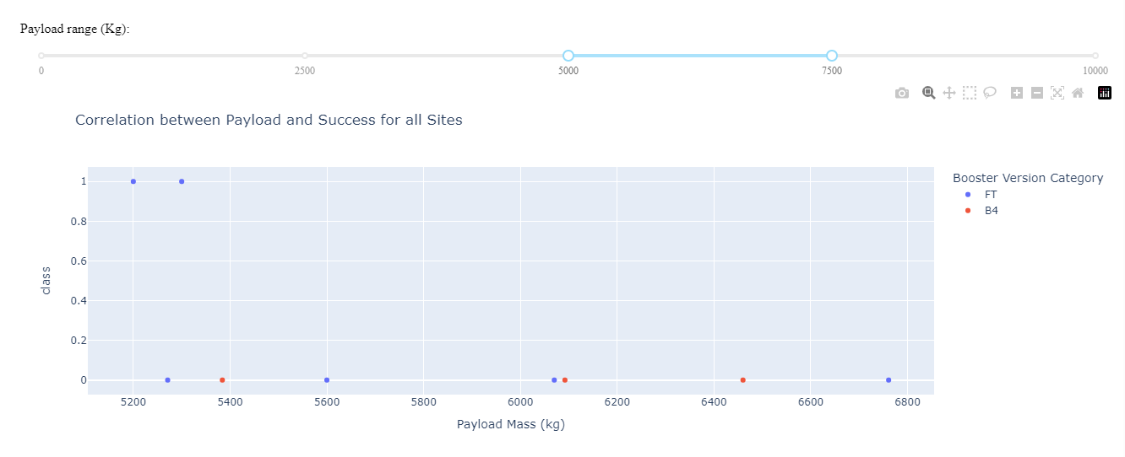
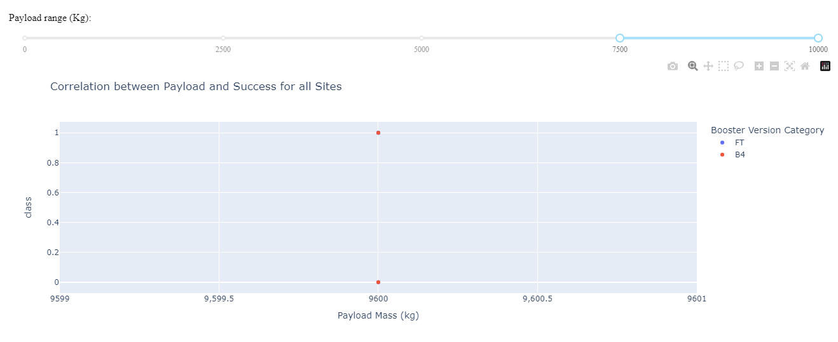
Payload vs. Launch outcome scatter plot for all sites
According to the plots the Payload range of (2500 to 5000) has the highest launch success rate (55%).
The payload in the range of (5000 to 7500) has the lowest launch success rate (22%).
For the payload in the range of (7500 to 10000) there was only two lunches, one successed, one failed.

Slide 50

Section 5

Slide 51
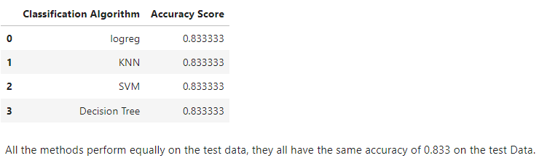
Classification Accuracy

Slide 52
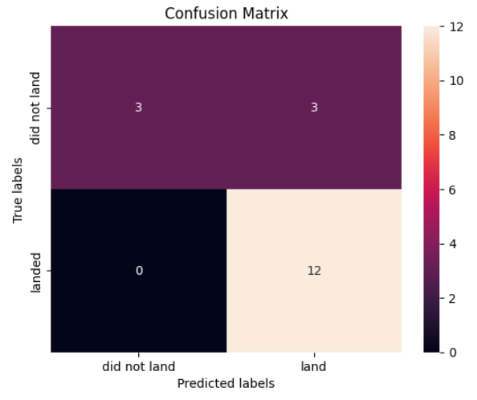
Confusion Matrix
All the 4 classification model had the same confusion matrixes and were able equally distinguish between the different classes. The major problem is false positive for all the models.

Slide 53
Conclusions
Different launch sites have different success rates. CCAFS LC-40, has a success rate of 60%, while KSC LC-39A and VAFB SLC 4E has a success rate of 77%.
We can conclude that as the flight number increases at each of the three launch sites, the success rate also improves. For example, the VAFB SLC 4E launch site achieves a 100% success rate after 50 flights, while both KSC LC 39A and CCAFS SLC 40 reach a 100% success rate after 80 flights.
If you observe Payload Vs. Launch Site scatter point chart you will find for the VAFB-SLC launch site there are no rockets launched for heavy payload mass greater than 10000.
The orbits ES-L1, GEO, HEO, and SSO boast the highest success rates at 100%, while GTO orbit has the lowest success rate, around 50%, and a 0% success rate for Orbit SO.
In LEO orbit, success seems to be linked to the number of flights; however, in GTO orbit, there doesn't appear to be any correlation between the flight number and success.
For heavy payloads, the successful landing rate is higher for Polar, LEO, and ISS missions. However, in the case of GTO, it's difficult to discern a clear pattern, as both successful and unsuccessful landings are present.
The success rate steadily increased from 2013 until 2020.
By applying various machine learning classification algorithms, we can predict the success or failure of landings with an accuracy of 0.833.

Slide 54


